Slide 2
Oracle Blockchain Cloud Service
name
Title
email

Slide 3
Notes:
This is a Safe Harbor Front slide, one of two Safe Harbor Statement slides included in this template.
One of the Safe Harbor slides must be used if your presentation covers material affected by Oracle’s Revenue Recognition Policy
To learn more about this policy, e-mail: Revrec-americasiebc_us@oracle.com
For internal communication, Safe Harbor Statements are not required. However, there is an applicable disclaimer (Exhibit E) that should be used, found in the Oracle Revenue Recognition Policy for Future Product Communications. Copy and paste this link into a web browser, to find out more information.
http://my.oracle.com/site/fin/gfo/GlobalProcesses/cnt452504.pdf
For all external communications such as press release, roadmaps, PowerPoint presentations, Safe Harbor Statements are required. You can refer to the link mentioned above to find out additional information/disclaimers required depending on your audience.

Slide 4
Agenda
Introduction to Enterprise Blockchain
Hands on Lab
1
2

Slide 5
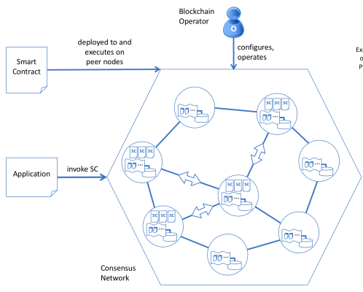
What is Blockchain
System for maintaining distributed ledgers in a peer-to-peer network
Allows multiple parties that may not fully trust one another to do business securely
Reduces need for third-party intermediaries
Near real-time and unalterable records replicated among all participants
Copyright © 2018, Oracle and/or its affiliates. All rights reserved.
5

Slide 6
Disruptive Characteristics/Benefits of Blockchain
Decentralized, peer-to-peer network – No central, controlling authority
Eliminating intermediaries means reduced transaction costs and near real-time transaction execution
Distributed ledger - All participants maintain a copy of the ledger
Eliminates manual efforts and delays due to reconciliation needs since data consistency is a key attribute of the distributed ledger
Immutable transaction history – Impossible to make changes to existing transactions in a blockchain without detection
Increased confidence in the information and reduced fraud opportunities
Smart contracts – Business logic deployed on a blockchain and shared and validated by participants.
Automated business processes in a trusted way. Represent any asset digitally.
Transparent – Transactions on a blockchain are visible to the authorized participants.
Increased auditability and trust, reduce cost of fraud and audits

Slide 7
Three Types of Blockchain
Public (a.k.a. “Permissionless”)
Permissioned
Private
Anyone can join the network and have a copy of the ledger
This involves the computer resource intensive mining process to add blocks cryptographically
Consensus models based on “proof of work”, “proof of elapsed time”, requiring a lot of processing power on many nodes
Closed ecosystem: members are invited to join and keep a copy of the ledger
Who members are in the real (legal) world is known (to at least the operators of the blockchain, but not necessarily all participants)
Consensus protocols depend on knowing who the members are, e.g., PBFT, for greater scalability
Internal to one organization only who controls all nodes
Useful for prototyping work, proof of concept and pilots

Slide 8
Agenda
Introduction to Enterprise Blockchain
Hands on Lab
1
2

Slide 9


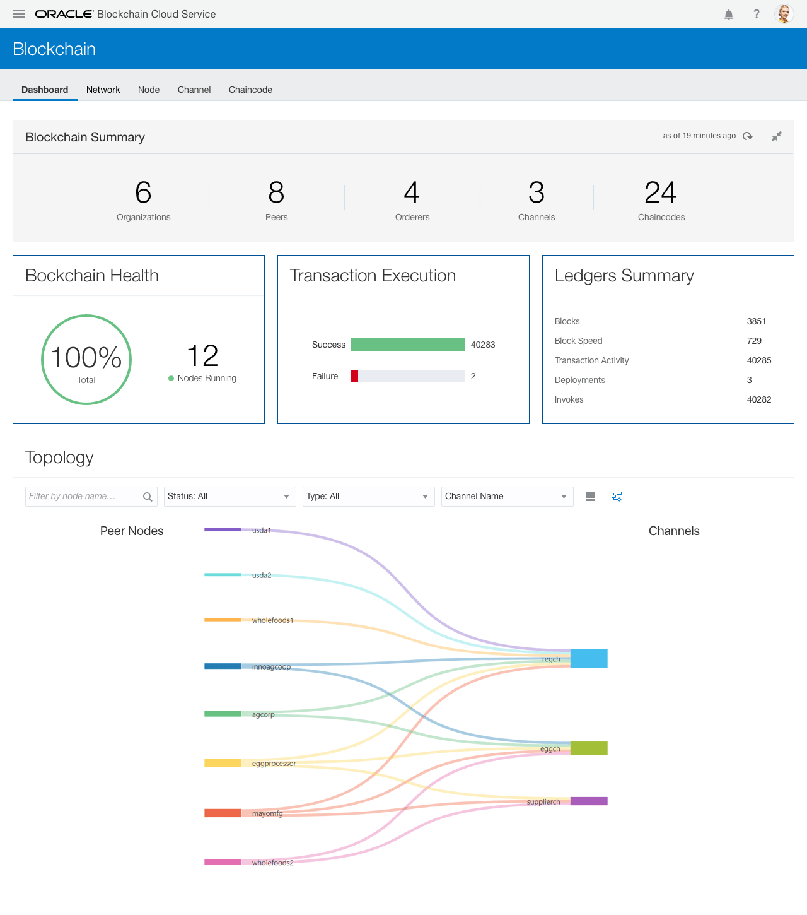

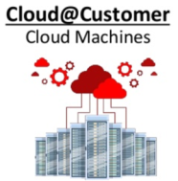
Oracle Blockchain Solution
Industrialized, hardened blockchain cloud platform for enterprise
Pre-assembled | Managed service | Production-ready | Public or private cloud
SaaS
REST
REST APIs for Integrations
Administration
Dynamic Configuration,
Monitoring and Troubleshooting
REST
gRPC
gRPC
On Premises
PaaS
Blockchain Nodes & Containers
Peer Nodes, Smart Contract Containers, Membership Services, Ordering Service, REST Proxy
Data Services
Object Store CS
NoSQL DB CS
Public Cloud
IaaS, SaaS, PaaS
Infrastructure and PaaS Services
Application Container CS (Managed Docker Containers), Identity CS (identity and key mgmt),
Event Hub CS (Kafka service), Management Service

Slide 10
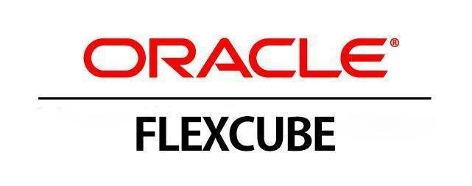
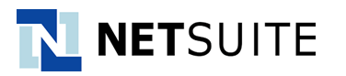

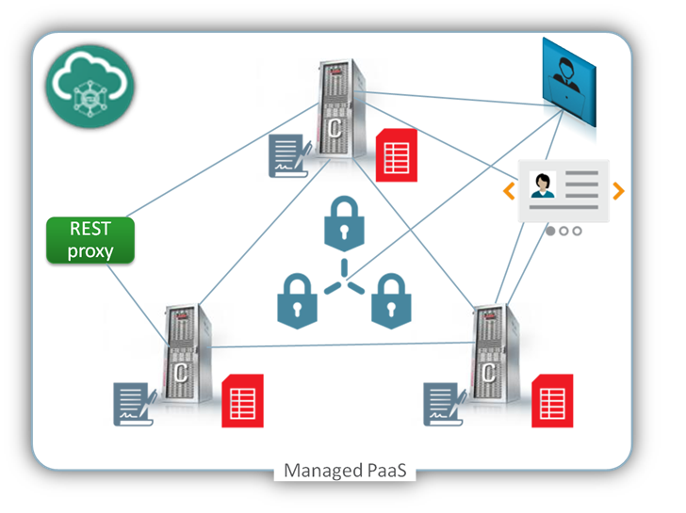



Integration Accelerators for OBCS
Legend
On-premises
ON-RAMPS WITH EMBEDDED APIS
SaaS
PaaS
Public or private cloud
OPEN BANKING API PLATFORM
SAAS APPLICATION INTEGRATION TOOLKITS
Sample templates & design patterns
Sample smart contracts & integration components
SaaS
PaaS
REST API-DRIVEN INTEGRATION
Invoke txn’s in sync & async mode
Get txn status
Query ledger data
SaaS
ORACLE INTEGRATION CLOUD
Adapters for Oracle & 3rd party applications in cloud and on-prem
Turn application events into REST calls to run blockchain transactions
SaaS
PaaS
PaaS
JAVA AND NODE.JS CLIENT SDKS
Invoke txn’s async
Get txn status
Query ledger data
Subscribe to events
Add channels/peers
Enroll new members
App
App

Slide 11
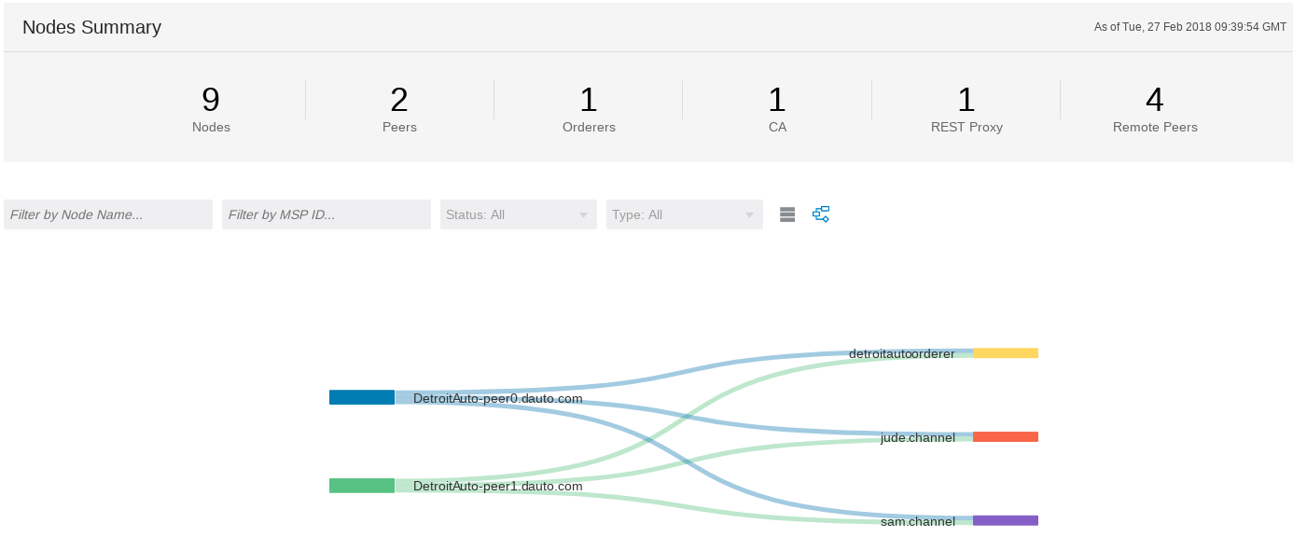
BCS Dealer Network setup
Network
Founder & Participants created and connected via separate channels
Chaincode / Smart Contract
Chaincode created and instantiated on all channels
Transactions
Initial load of sample transactions, blocks created

Slide 12
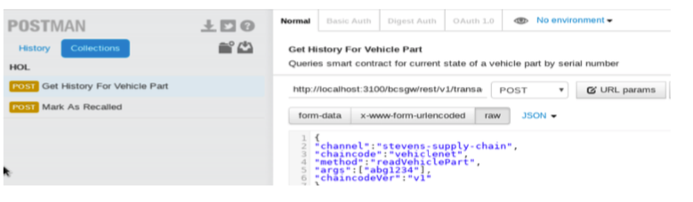
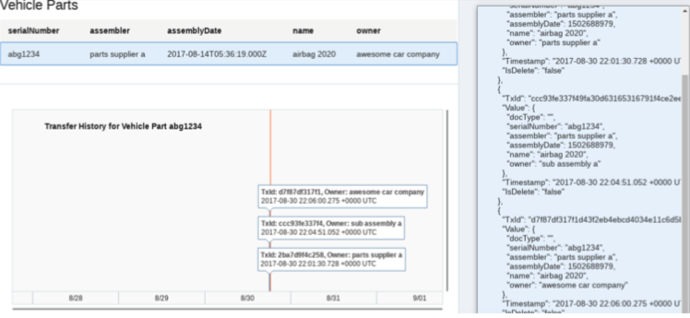
Working with the BCS network
REST API-DRIVEN INTEGRATION
Query ledger data
Invoke transactions
Get transaction status
Working with Postman
Using the REST API to work on the Blockchain
Working with sample apps
Visualizing BC / Ledger information

Slide 13
HoL Step by Step
Play the Blockchain Network Administrator
Create the Network Founder and the Organizations
Meet your HoL cloud instance
Connect to the internet
Be a Blockchain USER
Load initial values into your BC
Get the connection token
Check your instance access info
Import Orderer Settings
Share organization certificates
Create Channels
Deploy Smart Contracts
Invoke Smart Contracts by REST API
Use Client applications

Slide 14
Oracle Blockchain Cloud Service
Q&A
The most comprehensive distributed ledger cloud platform to securely extend your business processes and conduct online transactions in trusted networks with your suppliers, banks, and other trade counterparties
For more information:
Oracle.com/blockchain
Cloud.oracle.com/blockchain

